Slide 1


Smart Home
Smart Door Locking System
19BCT0082
JASSHU GARG

Slide 2
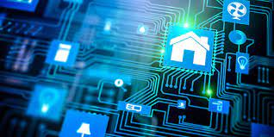
Domain: Smart Home
A smart home refers to a convenient home setup where appliances and devices can be automatically controlled remotely from anywhere with an internet connection using a mobile or other networked device.

Slide 3
How Smart Homes Work
A smart home’s devices are connected with each other and can be accessed through one central point—a smartphone, tablet, laptop, or game console.
Door locks, televisions, thermostats, home monitors, cameras, lights, and even appliances such as the refrigerator can be controlled through one home automation system.
The system is installed on a mobile or other networked device, and the user can create time schedules for certain changes to take effect.

Slide 4
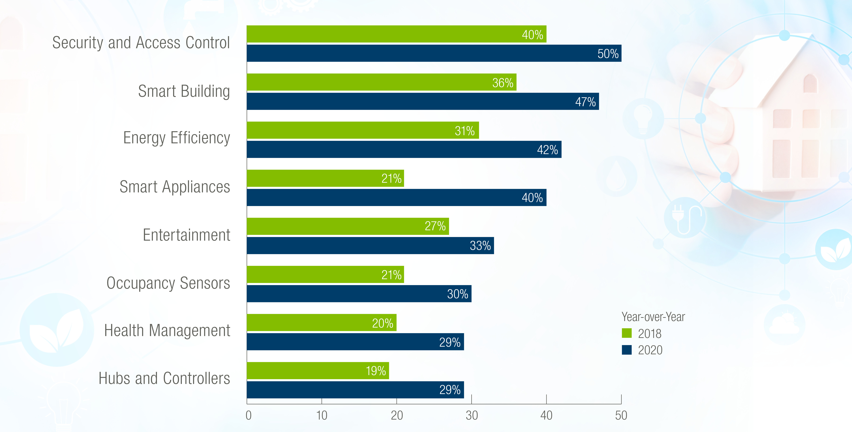
Current Trend
A recent global report projects global smart home market growth from $78.3 billion in 2020 to $135.3 billion in 2025
the growth in device production and development between 2018 to 2020 is a good indicator of competition for the future.

Slide 5

Issue on Focus – Smart Home Security
In India, Traditional CCTV Cameras is one of the most used device for security purposes
Drawbacks:
Don’t reduce crime
Doesn’t give value for money
Privacy is an issue
Can be misused
Older Security Methods are Single factor authentication based on mechanical techniques like keys-locks.

Slide 6
Issues
Security is a defence against threats which provides an assurance of safety.
Now and before security is one of the major concern in places like home, offices, institutions, laboratories etc. in order to keep our data confidentially so that no other unauthorized person could have access on them.
In olden days the security mechanisms are less in order to prevent unauthorized access.
Nowadays lot of security mechanisms have been introduced for such places and applications.
But along with a wide variety of security methods, the techniques of theft are also changing and it’s increasing day by day.
With the available systems we can protect home and institutions to some extent.

Slide 7

Statistics
On average, a burglary happens once every 30 seconds in world.
Rural states see more burglaries than those with big metropolitan hubs.
The Indian capital city of Delhi had the highest number of robbery cases, with over 1.9 thousand cases reported in 2019. Over 31 thousand robbery cases were reported across the country that year(2019).
Around 60% of burglars used forcible entry to gain access to a home

Slide 8
Statistics
30% entered the home through an unlocked door
In 70% of burglaries the burglar gains entry through a door
Many burglaries are not pre-planned, they’re carried out by opportunists who discover an open door, window or unguarded valuables in full view
Visible security measures, such as alarm boxes or CCTV cameras, are shown to reduce the chance of a property being targeted in a burglary

Slide 9

Smart Home Security
Smart home security uses your Wi-Fi network to connect entry sensors and sirens to devices like smart door locks, smart thermostats, and smart lightbulbs. Once connected, these devices can talk to each other and integrate with our security system to make our life more convenient and more secure.

Slide 10
Technology Perspective
Development in technology and capabilities in the IoT industry have directly influenced the growth in popularity of smart homes.
Increased functionality and internet connectivity providing remote accessibility and monitoring has been the main driving force behind this.
Users have adopted the technology to increase comfort and ease of living, as well as improve security surrounding the home environment and loved ones.
Security can be achieved with various new techniques

Slide 11
Technology Perspective
More security can be provided using various techniques
Various levels of authentication
Allow entry by our Permission only
Increasing/Decreasing levels of Security according to our needs
Various ways/techniques are
Passcode
RFID
FACE ID
Fingerprint
OTP
Encryptions
Cryptography
Many more

Slide 12
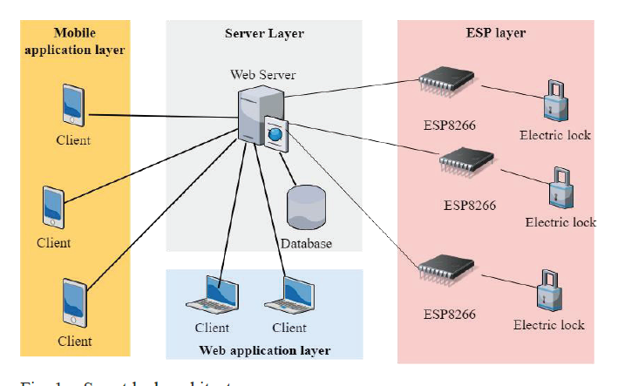
Architecture

Slide 13
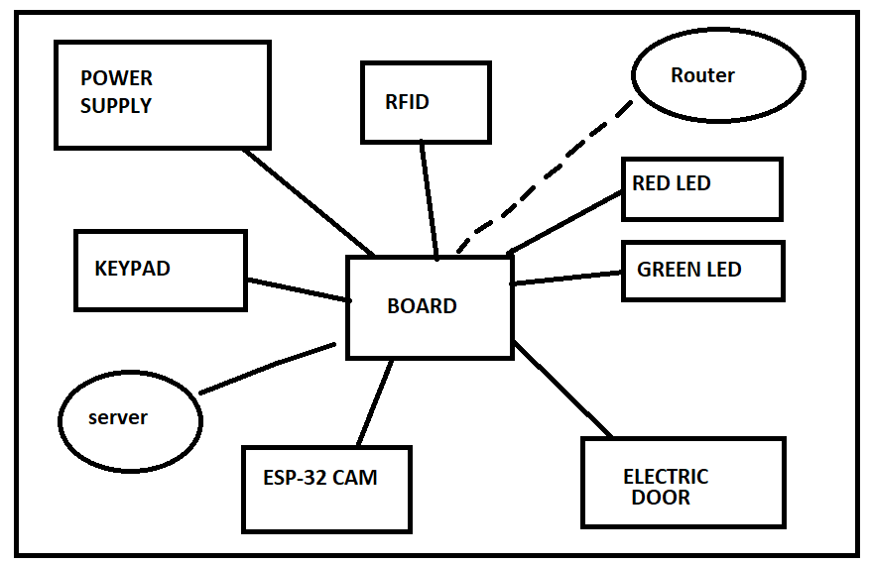
Architecture – Block Diagram

Slide 14
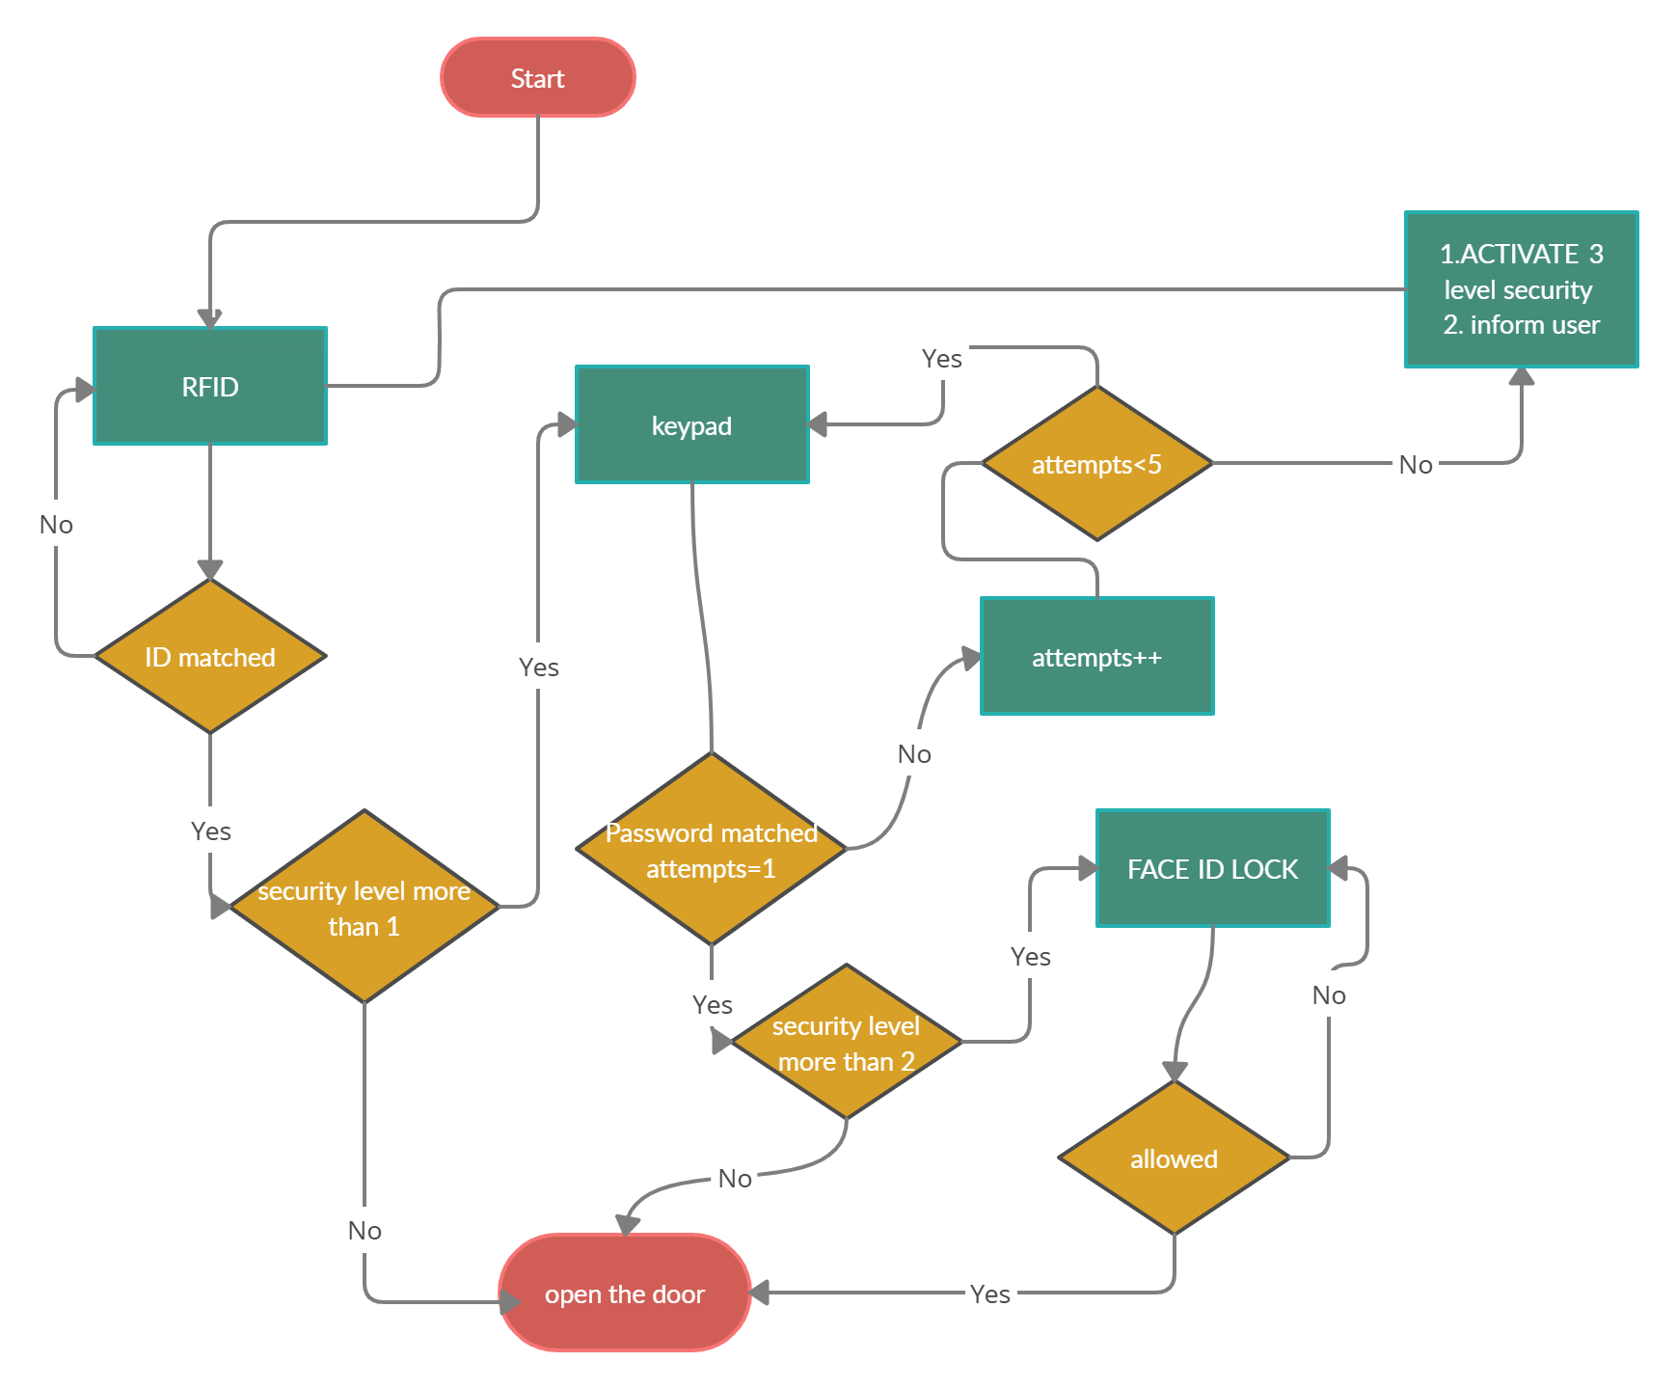
Proposed Solution

Slide 15
Existing Devices – Nest Secure
Nest Secure is a home security system.
The system consists of
Nest Guard (an alarm, keypad, and motion sensor with embedded microphone),
Nest Detect (a door/window and motion sensor), and
Nest Tag (a key chain fob).
The product was released in November 2017.
In February 2019, the Nest Guard received an update to add Google Assistant, allowing it to effectively double as a smart speaker similar to Google Home for general voice commands.

Slide 16
Existing Devices – Nest Secure
This addition has faced criticism, as the presence of a microphone inside the device was not disclosed in product specifications. Google stated that its inclusion of a microphone was accidentally not included in the listed specifications, and was originally intended to enable future sensor functionality.
On 19 October 2020, Google confirmed that the production of Nest Secure were discontinued officially. Google did not explain the reason behind discontinuation of Nest Secure, but did confirm the continuation of the service for the existing users.

Slide 17
Mathematical Model
Inputs :
LevelOfAuth(int) ,
RFIDpassed(0 or 1) ,
PasscodePassed(0 or 1) ,
FaceAllowed (0 or 1)
Outputs : Open the door(1) , Do not open the door & Start buzzer (0)
output = LevelOfAuth <= (RFIDpassed+PasscodePassed+FaceAllowed)

Slide 18
Modules
ESP-8266 (NodeMcu) in-built Wi-Fi Module
RFID Module
ESP-32 CAM Module
Relay Module
All these Modules can be used alone or in pairs to provide security with various levels

Slide 19
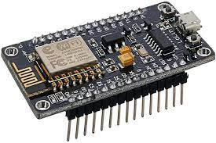
NodeMCU Module-
Microcontroller: Tensilica 32-bit RISC CPU Xtensa LX106
Operating Voltage: 3.3V
Input Voltage: 4.5-10V
Digital I/O Pins (DIO): 16
Analog Input Pins (ADC): 1
UARTs: 1
SPIs: 1
I^2Cs: 1
Flash Memory: 4 MB
SRAM: 64 KB
Clock Speed: 80 MHz
USB-TTL based on CP2102 is included onboard, Enabling Plug n Play
PCB Antenna
Small Sized module to fit smartly inside IoT projects
Notes:
SPI stands for Serial Peripheral Interface
Universal asynchronous receiver-transmitter (UART)
I²C (Inter-Integrated Circuit)

Slide 20
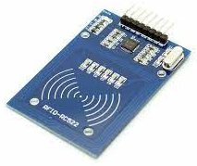
RFID Module-
Integrated MF RC522
13.56MHz contactless communication card chip.
The low-voltage, low-cost, small size of the non-contact card chip to read and write.
Working current：13 – 26mA / DC 3.3V
Standby current：10 – 13mA / DC 3.3V
Sleep current：<80uA
Peak current：<30mA
Working frequency：13.56MHz
Card reading distance ：0～60mm （Mifare1 card）

Slide 21
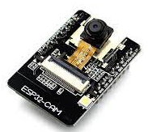
ESP-32 CAM Module-
The smallest 802.11b/g/n Wi-Fi BT SoC Module
Low power 32-bit CPU
Up to 160MHz clock speed
computing power up to 600 DMIPS
Built-in 520 KB SRAM, external 4MPSRAM
Supports UART/SPI/I2C/PWM/ADC/DAC
Support OV2640 and OV7670 cameras, Built-in Flash lamp.
Support image Wi-Fi upload
Support TF card
Supports multiple sleep modes.
Supports STA/AP/STA+AP operation mode
Support Smart Config/Air Kiss technology
Support for serial port local and remote firmware upgrades (FOTA)
Notes:
Dhrystone MIPS (Million Instructions per Second), or DMIPS, is a measure of computer performance relative to the performance of the DEC VAX 11/780 minicomputer of the 1970s.
TransFlash

Slide 22
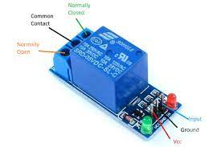
RELAY Module-
Relays control one electrical circuit by opening and
closing contacts in another circuit.
Supply voltage – 3.75V to 6V
Quiescent current: 2mA
Current when the relay is active: ~70mA
Relay maximum contact voltage – 250VAC or 30VDC
Relay maximum current – 10A

Slide 23
Correlation of Modules
Relation between each Component depends on the user’s choice
One of the most important Factor is depending on Level of Security/Authentication
Single level authentication : Only one Module/Sensor will operate , plus the processing of other modules will not even considered
Two Level authentication : One Module/sensor will operate and authenticate at its level and if the user is authenticated it will consider the working/processing/operation of 2nd selected Module/Sensor will be considered
Similarly We can Increase the Module/Sensors and they will correlate with each other.

Slide 24
Objectives
The main aim is to provide security using Smart Door
With various levels of authentication
Get Instant alerts
View who is on another side of door from anywhere in the house
Manage security system of house
Preventing entry of burglars
Indirectly , preventing monetary loses
Preventing threat
More safety

Slide 25
Conclusions
The problem has been formulated and various studies have been reviewed regarding the different electronic lock systems. RFID technology is one of the successfully incorporated in the door lock system. There by providing a three-way security mechanism with RFID, Passcode, Face ID provides security at next level.
The administrator of the central server-system can terminate the validity of any user at anytime to avoid unexpected situations.
Finally, a multi-level authentication digital door access control system can be used in critical zones like Military Institute, Defence, Scientific Laboratory, etc too. which is cost effective and increase the scale of security successfully.

Slide 26
References
https://www.cssltd.co.uk/home-security-facts-and-figures/
https://www.safewise.com/blog/8-surprising-home-burglary-statistics/
https://www.indiatoday.in/impact-feature/story/every-3-minutes-a-burglary-robbery-or-a-break-in-is-taking-place-in-india-and-its-time-we-reconsidered-the-safety-levels-of-our-homes-1621113-2019-11-21
https://www.indiatoday.in/impact-feature/story/every-3-minutes-a-burglary-robbery-or-a-break-in-is-taking-place-in-india-and-its-time-we-reconsidered-the-safety-levels-of-our-homes-1621113-2019-11-21
https://www.mdpi.com/2227-7390/7/6/490/htm
https://en.wikipedia.org/wiki/Google_Nest
https://ieeexplore.ieee.org/abstract/document/8076773/similar
https://components101.com/development-boards/nodemcu-esp8266-pinout-features-and-datasheet
https://robu.in/product/rc522-rfid-card-reader-module-13-56mhz/

Slide 27
References
[1].Smart Homes: Security Challenges and Privacy Concerns arXiv:2010.15394v1 [cs.CR] 29 Oct 2020
[2].A Digital Security System with Door Lock System Using
[3].RFID Technology International Journal of Computer Applications (0975 – 8887) Volume 5– No.11, August 2010
[4].Internet of Things and Smart Home Security ISSN: 04532198 Volume 62, Issue 05, June, 2020
[5].Internet of Things Cyber Security: Smart Door Lock System Marko Pavelić,Zvonimir Lončarić,Marin Vuković,Mario Kušek University of Zagreb
[6].Super Secure Door Lock System For Critical Zones. Meera Mathew, Divya R S
[7].Smart Door Locking System ISSN: 2278-0181
[8].IOT BASED DOOR ACCESS CONTROL SYSTEM USING FACE RECOGNITION ID No: 300183

